Slide 1
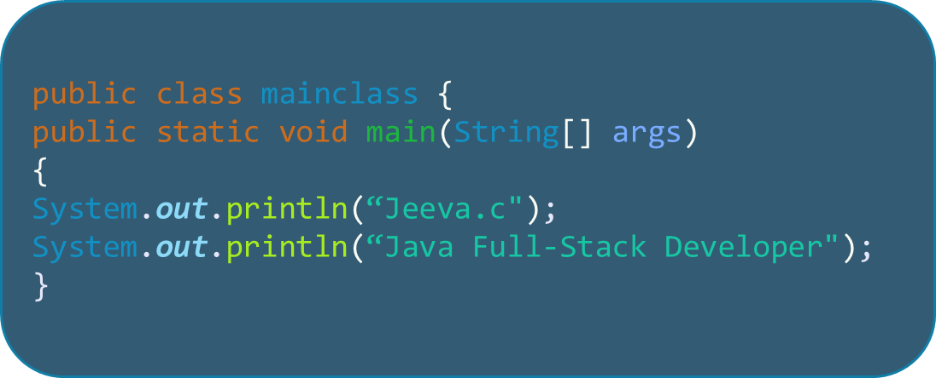
JJeeva.c
Java Full-Stack Developer

Slide 2
Java Operators
An Overview of Operators in Java

Slide 3
Introduction
Operators are special symbols or keywords used in Java to perform operations on variables and values. They are the building blocks of Java programming.
1.Arithmetic operators 5.Relational operators
2.Assignment operators 6.Unary operators
3.Bitwise operators 7.Shift operators
4.Logical operators 8.Ternery operators

Slide 4
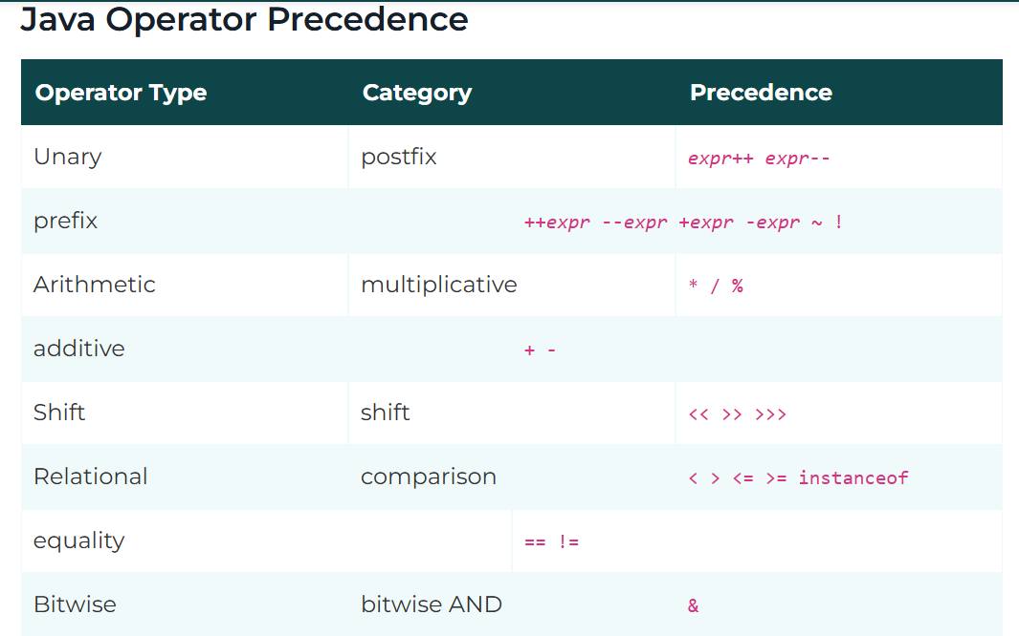

Slide 5
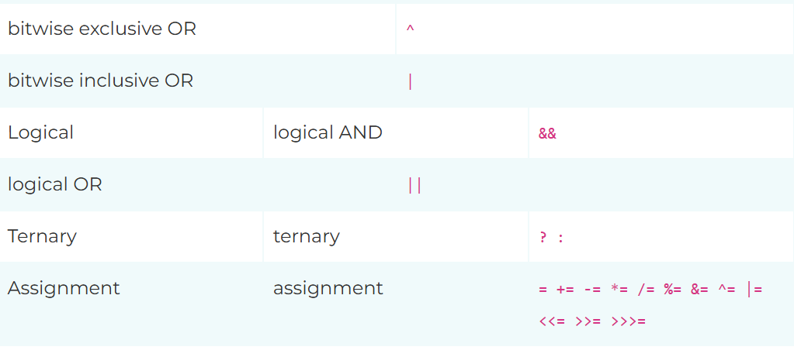

Slide 6
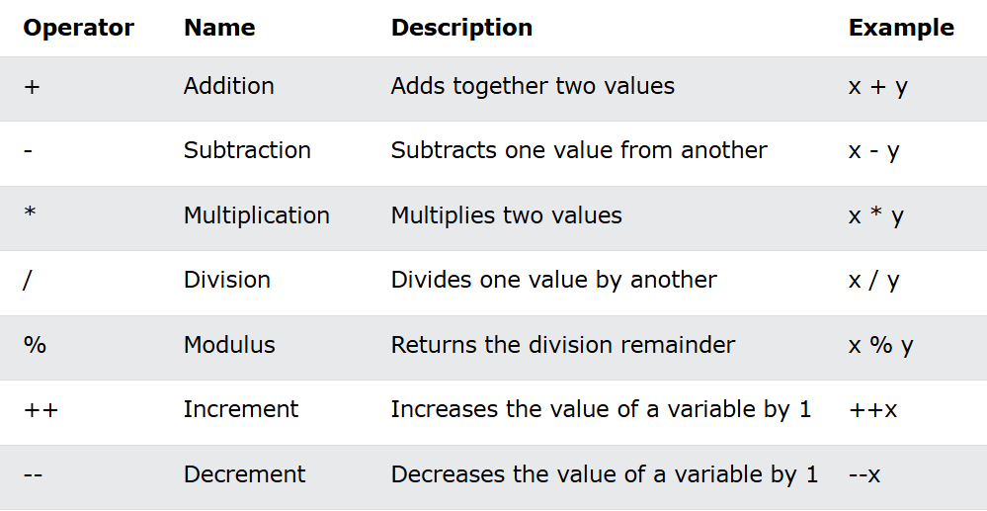
Arithmetic Operators
Arithmetic operators are used to perform common mathematical operations.
Notes:
Example: int a = 10, b = 5; System.out.println(a + b); // Output: 15

Slide 7
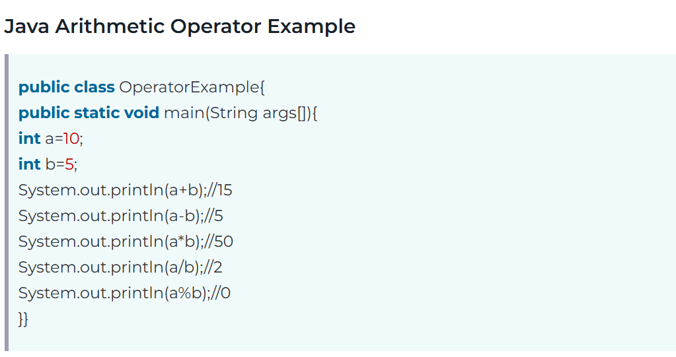
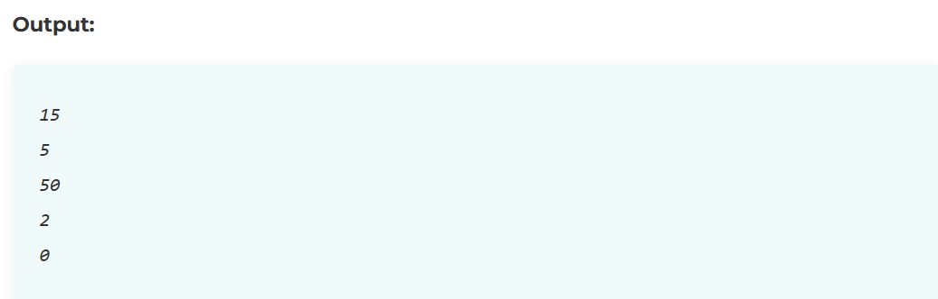

Slide 8
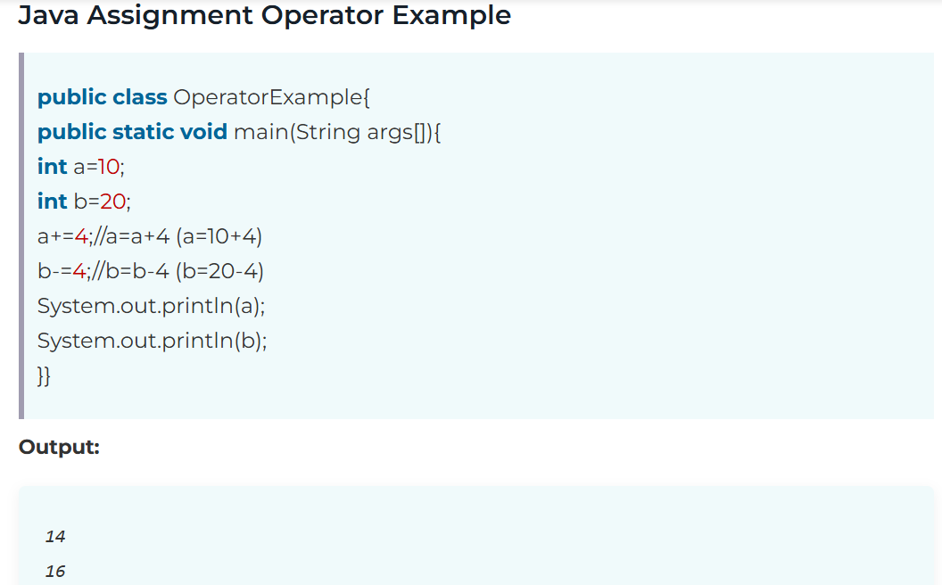
Assignment Operators
Notes:
Example: int a = 10; a += 5; System.out.println(a); // Output: 15

Slide 9
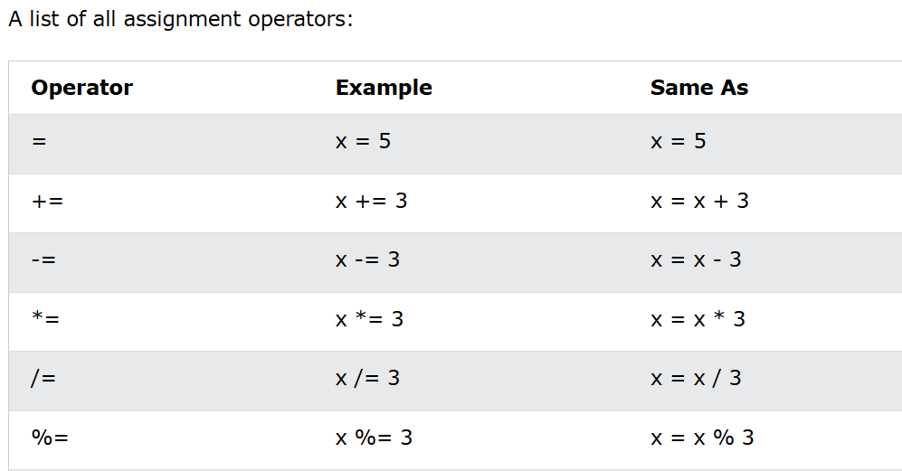
Assignment Operators
Assignment operators are used to assign values to variables.
In the example below, we use the assignment operator (=) to assign the value 10 to a variable called x:
Notes:
Example: int a = 10, b = 5; System.out.println(a > b); // Output: true

Slide 10
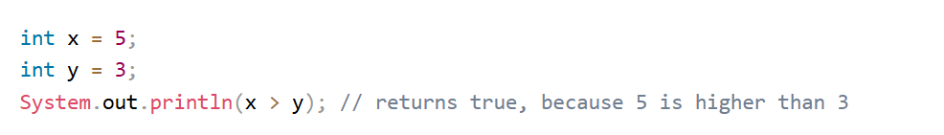
Relational operators
Operator which is Used to compare Two values
Eg, 5>4
Here > is a comparison operator here we are comparing two value.
Eg,
Notes:
Example: int a = 10, b = 5; System.out.println(a > 5 && b < 10); // Output: true

Slide 11
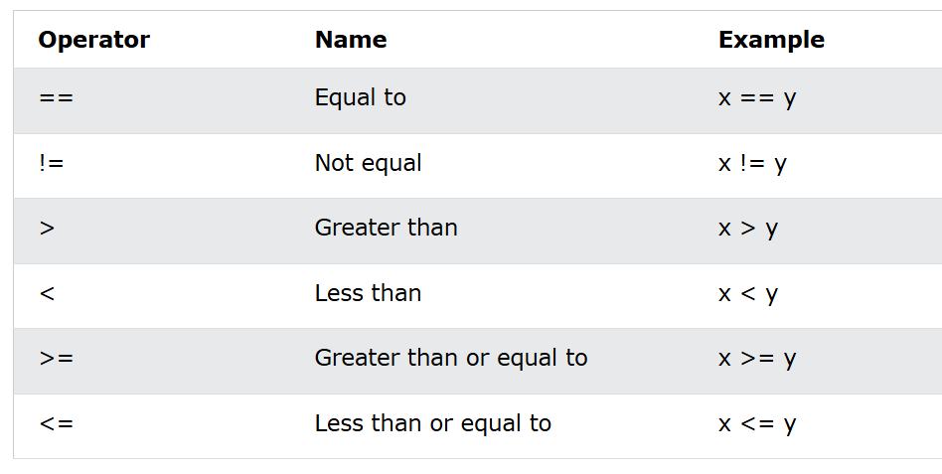

Slide 12
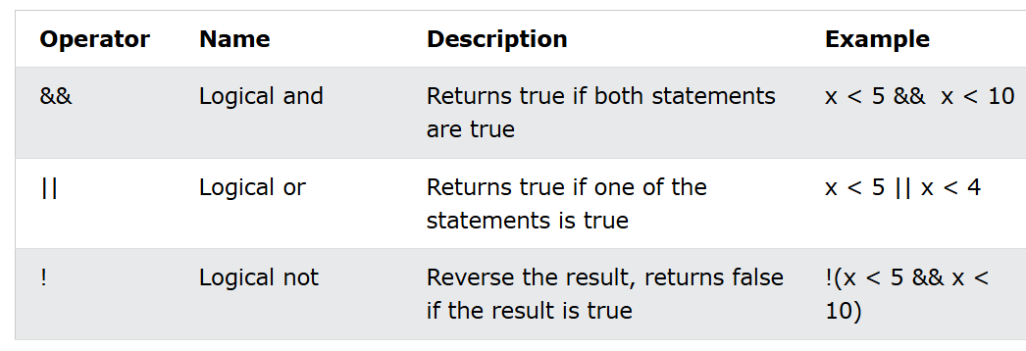
Logical operators
In java, Logical operators are symbols that connect two or more expressions od Boolean type (i.e., true or false) and return a Boolean value as a result.
Notes:
Example: int a = 5, b = 3; System.out.println(a & b); // Output: 1

Slide 13
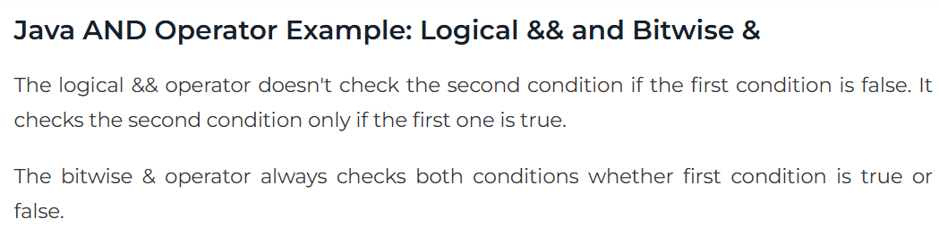
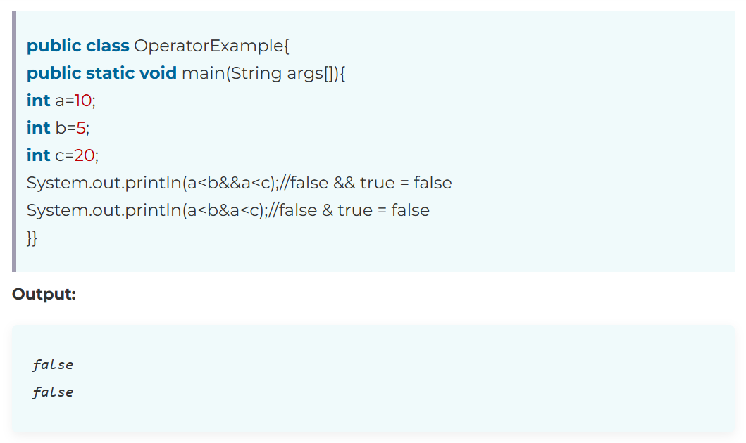

Slide 14
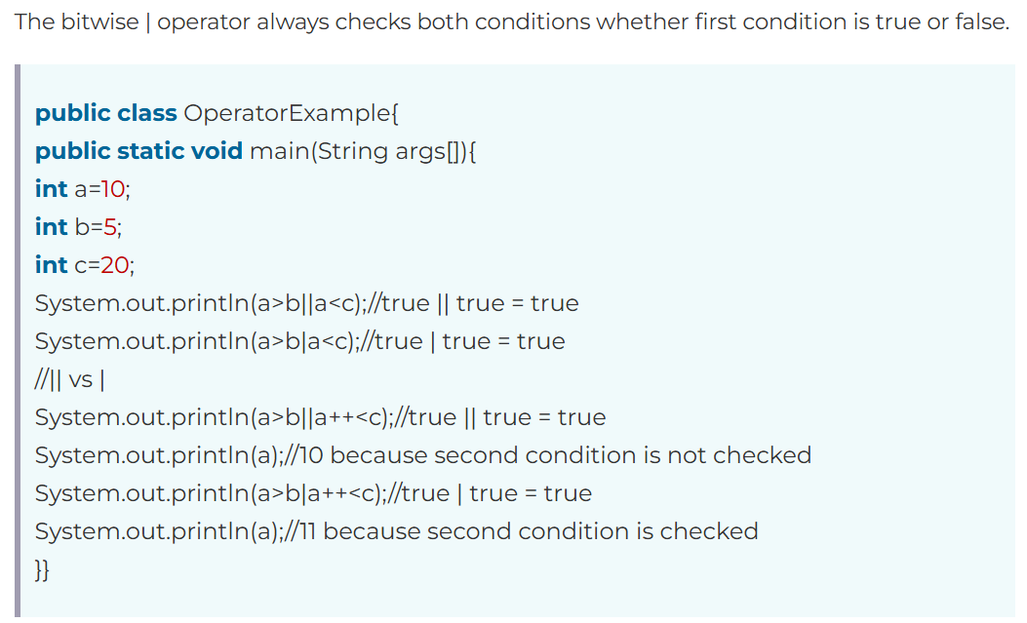
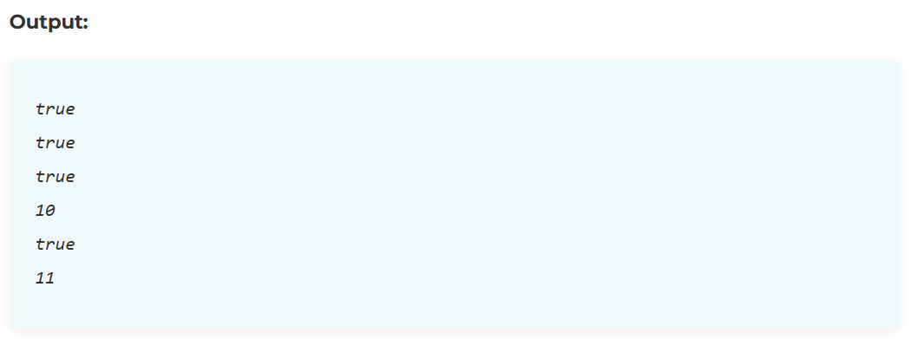

Slide 15
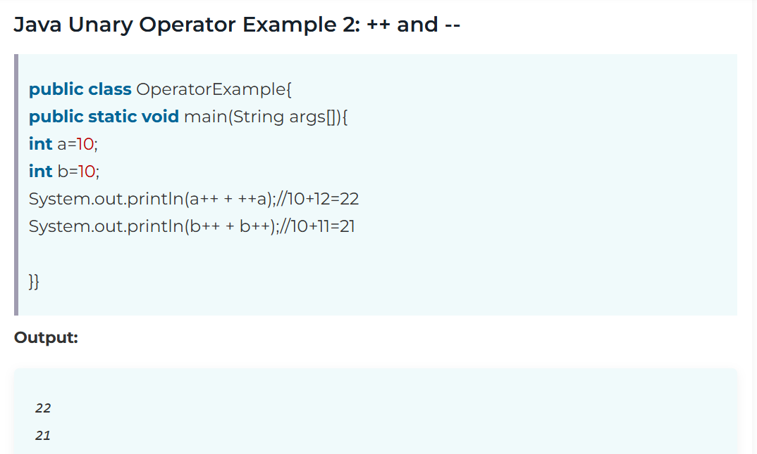
Unary Operators
:
The Java unary operators require only one operand. Unary operators are used to perform various operations i.e.
incrementing/decrementing a value by one
negating an expression
inverting the value of a boolean
Notes:
Example: int a = 10; a++; System.out.println(a); // Output: 11

Slide 16
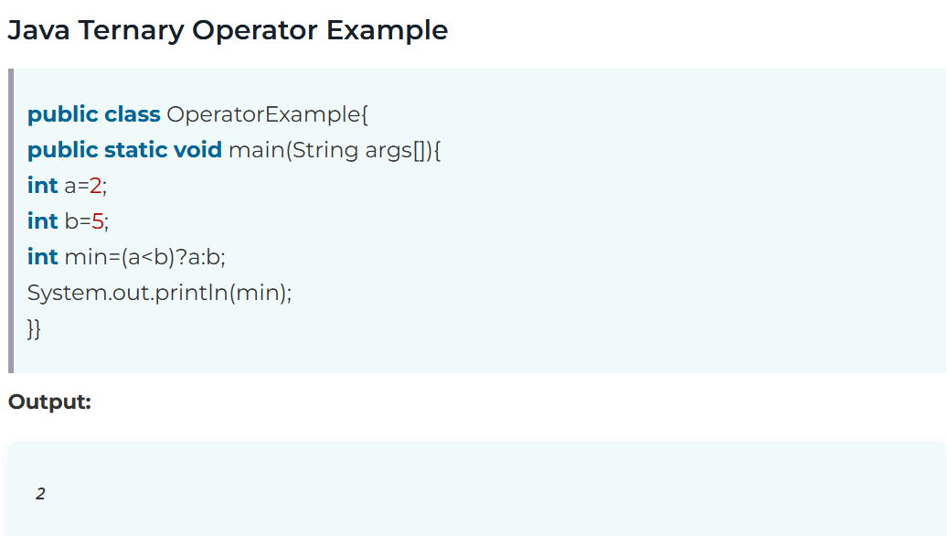
Ternary Operator
Notes:
Example: int a = 10, b = 5; int max = (a > b) ? a : b; System.out.println(max); // Output: 10

Slide 17
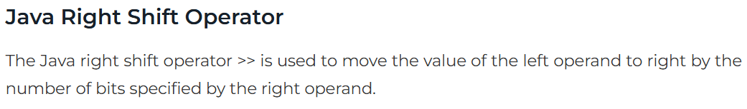
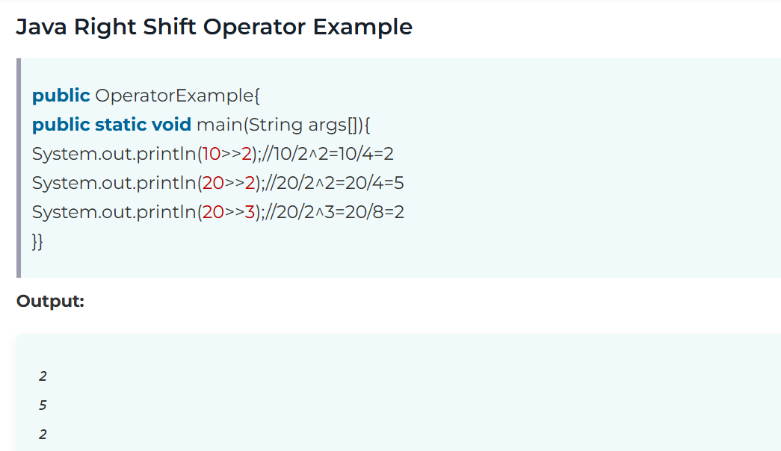
Shift Operators

Slide 18
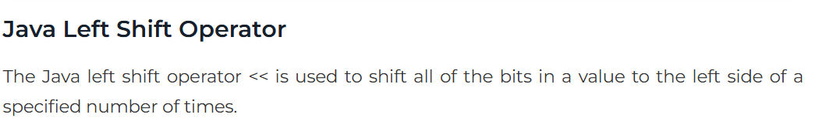
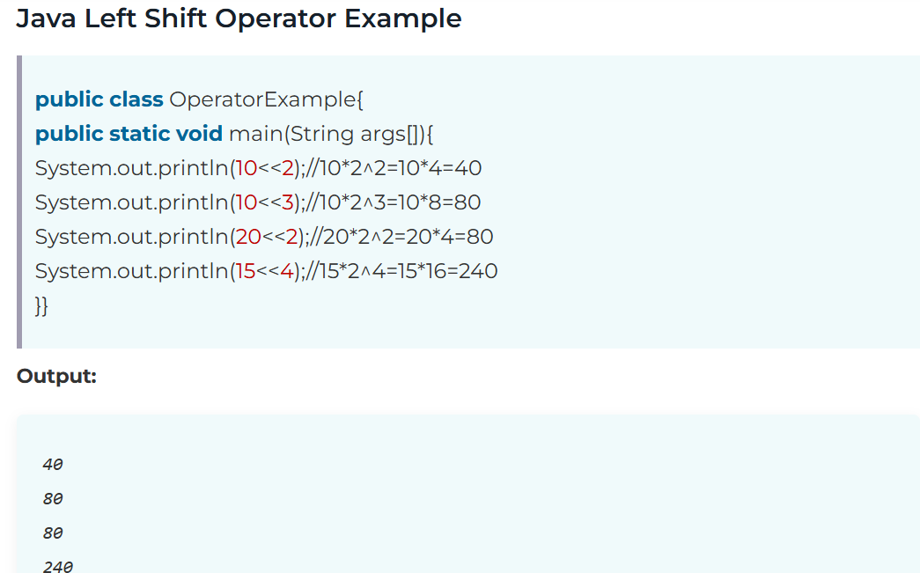

Slide 19
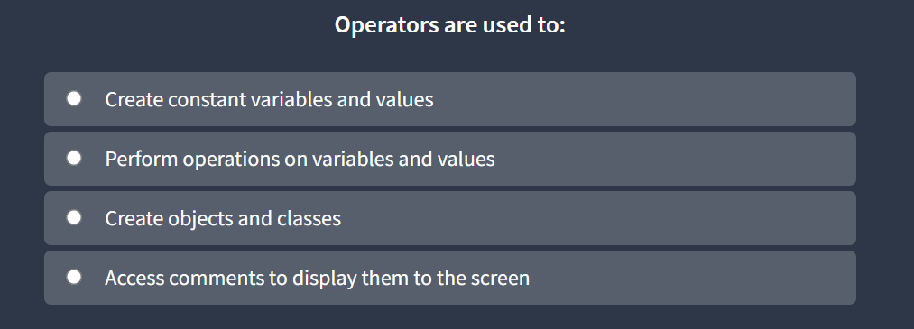

Slide 20
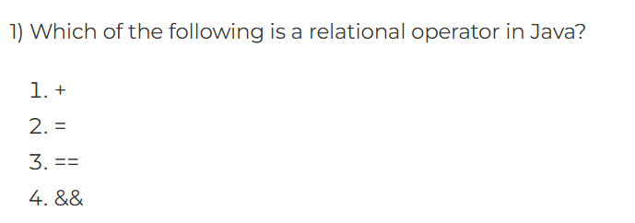
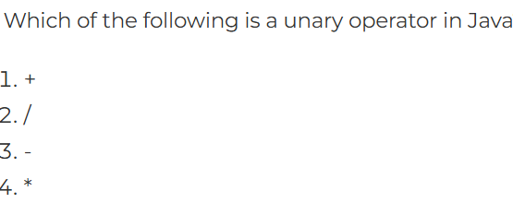
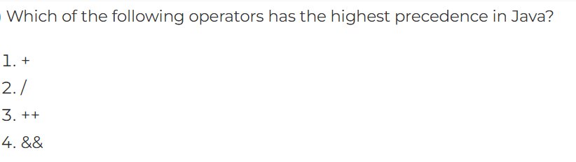

Slide 21
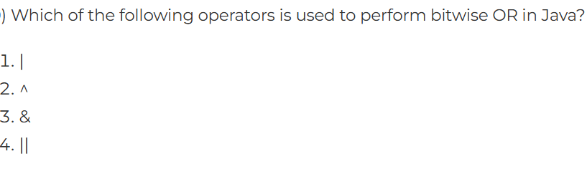
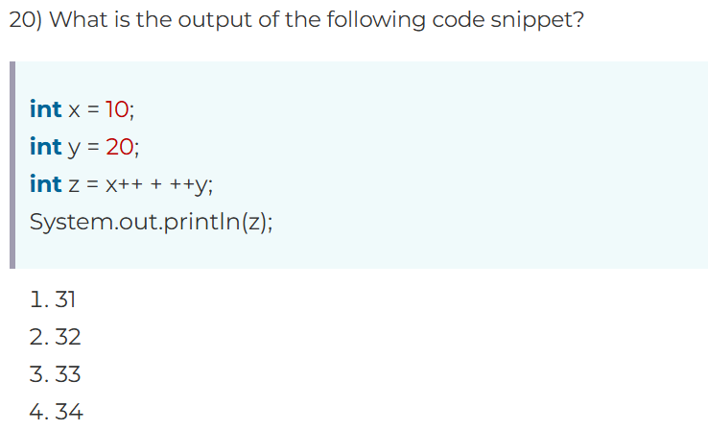

Slide 22
Conclusion
Java provides a wide range of operators to make programming efficient and expressive. Understanding and using these operators effectively is key to writing robust code.

Slide 23
public class mainclass {
public static void main(String[] args)
{
System.out.print(“THANK YOU !");
}
THANK YOU!

